Slide 1

Regression Analysis
Presentation By : ARCHIT GARG
23BSPO326

Slide 2

Description
This Dataset Contains the Historical Share Price of Tata Consultancy Services ltd(TCS) From 2002 to 2004.
This Dataset Contains six columns Date
-- open value of the TCS stock price on particular day High
-- high price value of TCS on particular day LOW
-- Low Price Value Of TCS on particular day Close
--Stock Price of TCS After Closing The Stock Market Volume
-- Volume of TCS means sum of buy's and shares Adjclose
--Adjusted close is the closing price after adjustments for all applicable splits and dividend distributions .

Slide 3
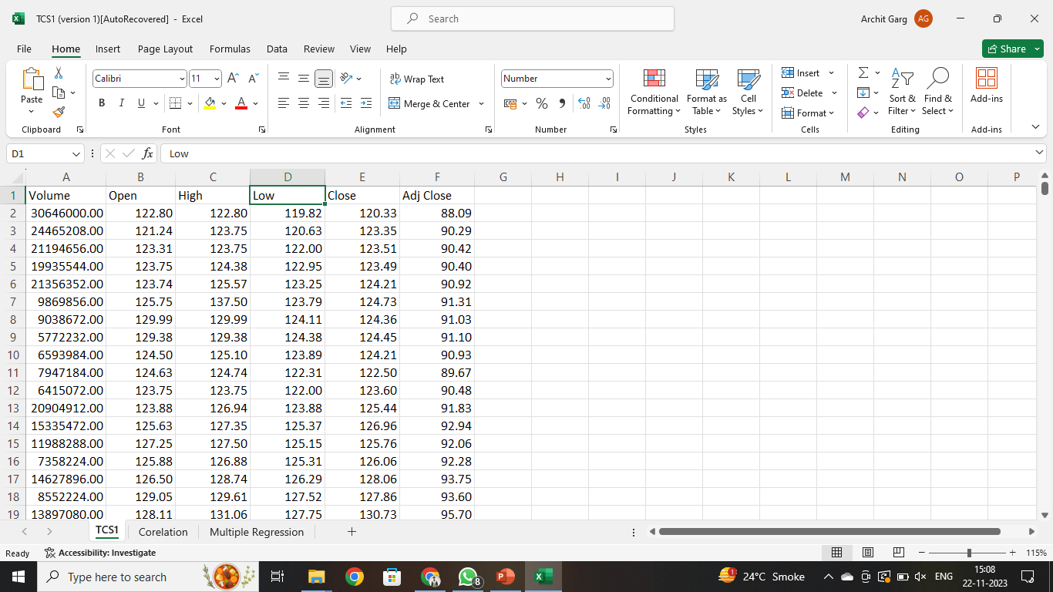
DATASET

Slide 4
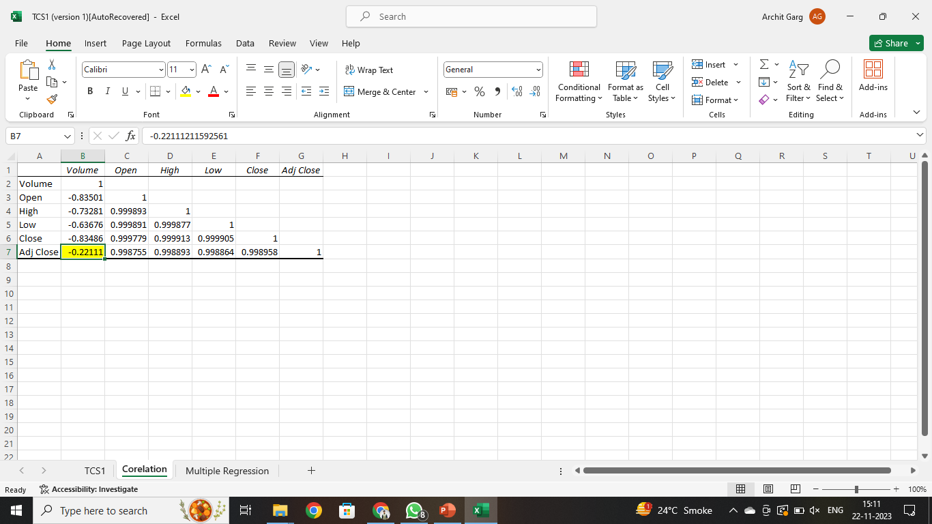
CORRELATION MATRIX

Slide 5
CORRELATION INTERPETATION
Here are some specific interpretations of the correlation coefficients in the matrix:
The strong positive correlation between Open and High (0.999) suggests that the stock market is generally trending upwards.
The strong positive correlation between Open and Close (0.999) suggests that the stock market is generally closing higher than it opens.
The strong positive correlation between High and Low (0.999) suggests that the stock market is generally trading within a narrow range.
The moderate positive correlation between Volume and Open (0.221) suggests that there is a tendency for trading volume to increase when the stock market opens higher.

Slide 6
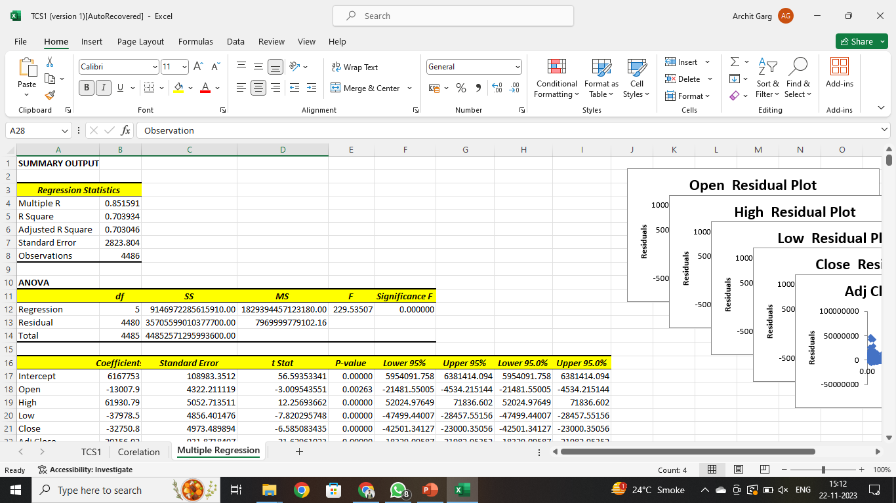
REGRESSION ANALYSIS

Slide 7
REGRESSION INTERPETATION
Multiple R: 0.851591
This is the correlation coefficient between the predicted and actual values of the dependent variable. A value of 0.851591 indicates a strong positive correlation, suggesting that the model is able to explain a large proportion of the variation in the dependent variable.
R-Squared: 0.703934
This is the coefficient of determination, which measures the proportion of the variation in the dependent variable that is explained by the independent variables. A value of 0.703934 indicates that the model is able to explain 70.39% of the variation in the dependent variable.
Adjusted R-Squared: 0.703046
This is a modified version of R-Squared that takes into account the number of independent variables in the model. It is generally considered to be a more reliable measure of the model's fit than R-Squared.
Standard Error: 2823.804
This is a measure of the variability of the residuals, which are the differences between the predicted and actual values of the dependent variable. A lower standard error indicates that the model is more accurate

